Slide 1
X Education Company
Lead score case study
By
Aparna KisHAN
Jayasree RAMAKrishnan
Manu gundala

Slide 2
Business Objective :
To help X Education select most promising leads who can be converted to successful customers.
Company CEO expectation is converting 80% of leads into customers, taking up their product services.
History of Lead conversion data is given from the sales team with insights.
Data set can be used to build a model to predict potential leads and provide useful recommendations to focus and attain maximum benefits and working principles to identify the right category of customers, so as to reduce time and cost.

Slide 3
Approach :
To build a Logistic Regression Model that assigns a Lead Score between 0 and 100 to all the leads such that the leads with higher score have a higher probability of becoming a successful customer of X Education.
Target Lead Conversion rate is 80%

Slide 4
Step 1: Data IMPORT AND CLEANING
Import and Understand the data set provided by the Sales Team
Data Cleaning
Dropping duplicate rows and unwanted columns
Replacing ‘Select’ with null values
Handling null values

Slide 5
Step 2: Data Visualization and Exploratory data analysis
Visualize Categorical variables
Drop variables with low variance or imbalanced data
Group together less frequent categories
Visualize Numeric variables
Check for correlations
Handle Outliers

Slide 6
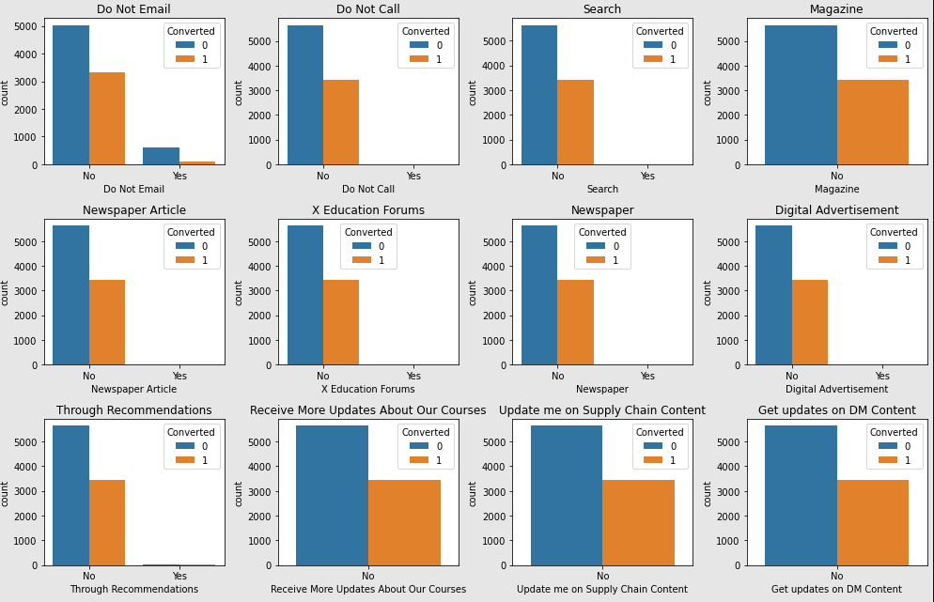
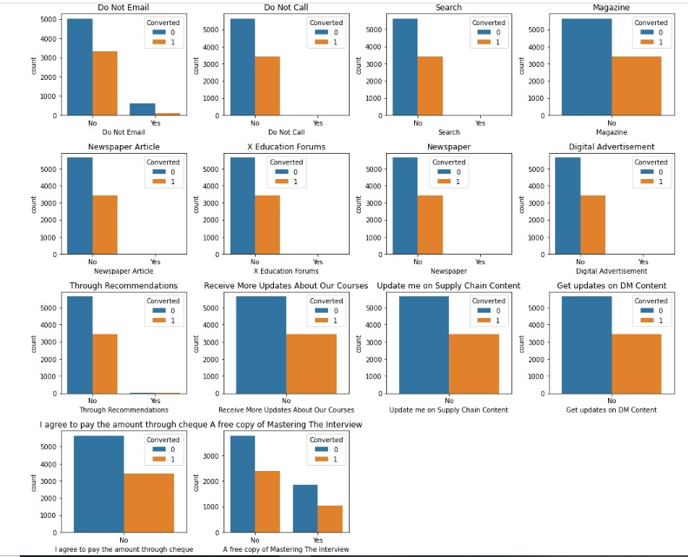
Visualizing Binary Features
The graph shows that many variables have low variance. i.e., majority or all of the values are 'No’.
Since this doesn’t provide any insight for our analysis, we dropped such columns.

Slide 7
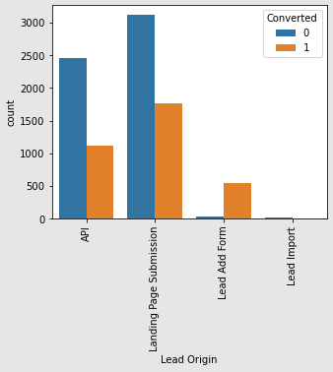
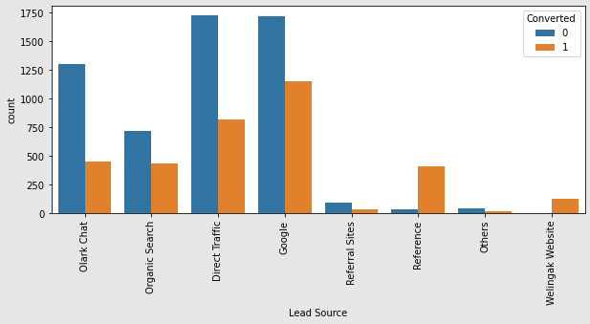
Visualizing Categorical Features
Lead Origin :
Landing Page Submissions and API have higher number of conversions.
Lead Add From has a high conversion rate however the number of leads is less.
Lead Source :
Direct Traffic and Google have comparatively higher number of conversions.
Leads obtained by Reference have a very high chance of conversion

Slide 8
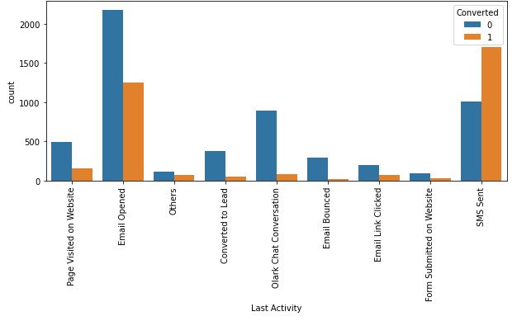
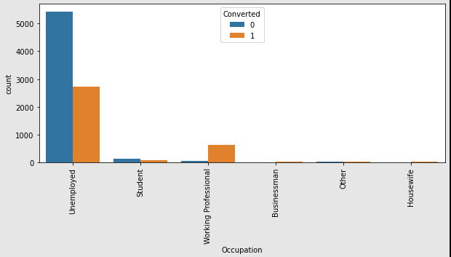
Visualizing Categorical Features
Lead Activity :
Email opened has the highest number of leads.
SMS sent indicates a high chance of conversion.
Olark Chat Conversation has a large number of leads but the conversion rate is too low.
Occupation :
Leads are high among unemployed people
Rate of conversion is high among Working Professional

Slide 9
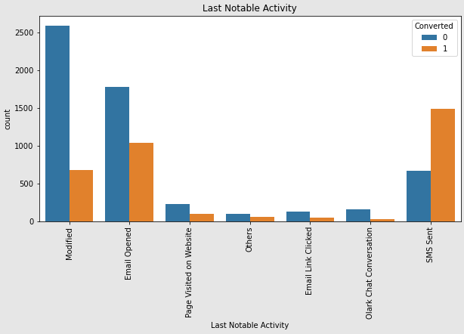
Visualizing Categorical Features
Lead Notable Activity :
Modified and Email opened have higher number of Leads
SMS sent indicates a high chance of conversion

Slide 10
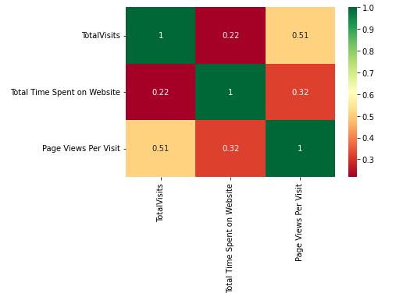
Visualizing Numerical Features
There doesn’t seem to be high correlation between numeric features

Slide 11
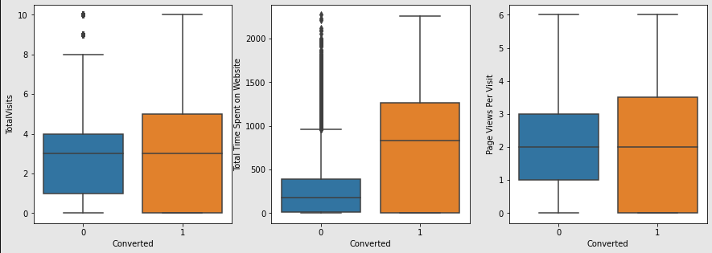
Visualizing Numerical Features
People who spent more time on website are more likely to become converted leads

Slide 12
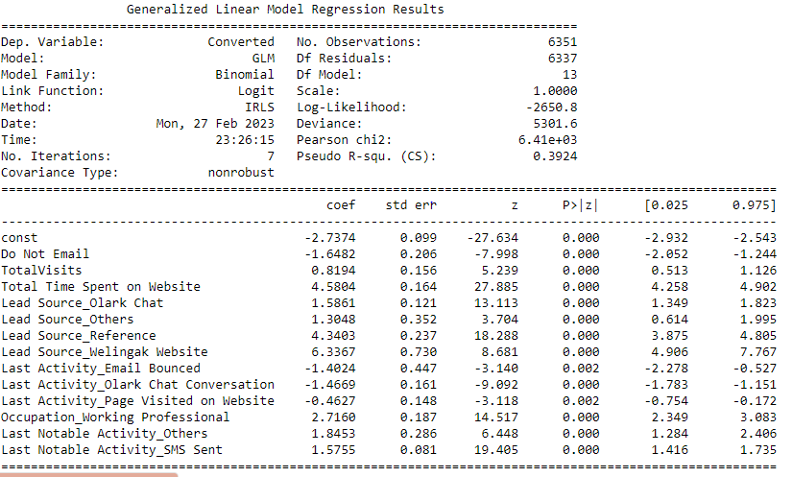
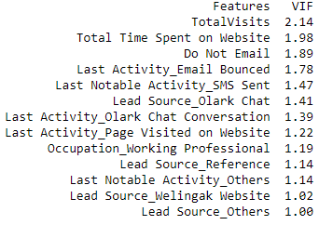
Model Summary
VIF Values of features in Final Model
All the features have p value less than 0.05 and VIF less than 5

Slide 13
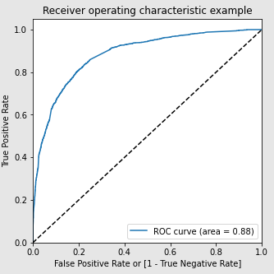
Model Evaluation : ROC Curve
Area under the curve is 0.88, which means the predictive power of the model is good

Slide 14
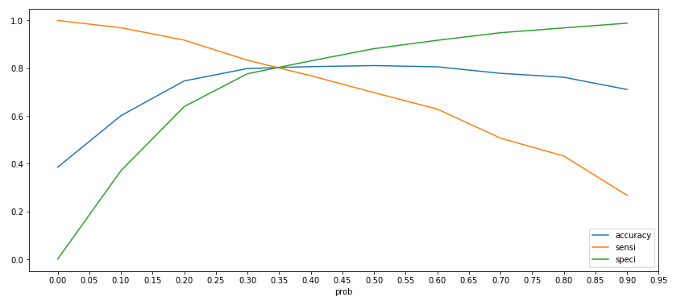
Model Evaluation : Optimal Cut-Off Threshold
To get a balanced Accuracy, Sensitivity and Specificity, we determined the Optimal Cut-Off Threshold as 0.34

Slide 15
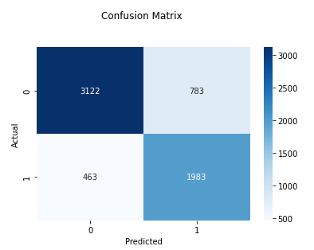
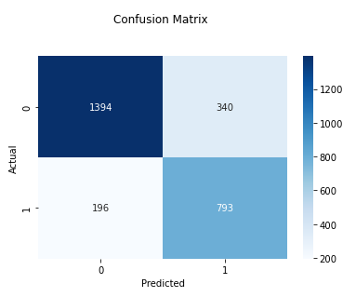
Model Evaluation : Confusion Matrix
Train Data
Test data

Slide 16
Model Evaluation :
Evaluation Data | Train Data | Test Data
Accuracy | 0.80 | 0.80
Sensitivity | 0.81 | 0.80
Specificity | 0.80 | 0.80
False Positive Rate | 0.20 | 0.20
Positive Predictive Value | 0.72 | 0.70
Negative Predictive Value | 0.87 | 0.89
F1-Score | 0.76 | 0.75

Slide 17
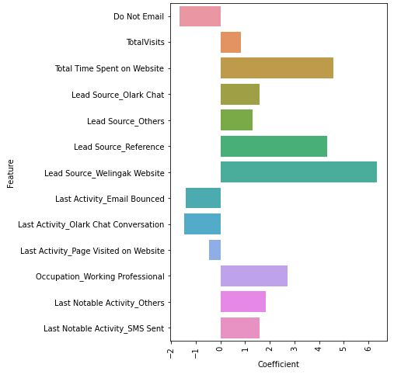
Conclusion:
The final model has 13 features and the accuracy of the model is 80.32% at an optimal threshold of 0.34
Features having positive impact on conversion probability
Total Visits
Total Time Spent on Website
Lead Source :
Olark Chat
Reference
Welingak Website
Others
Occupation
Working Professional
Last Notable Activity
SMS Sent
Others
Features having negative impact on conversion probability
Do Not Email
Last Activity
Email Bounced
Olark Chat Conversation
Page Visited on Website

Slide 18

Thank You

